Slide 1
Proposal Presentation ON
Online Ecommerce Shop

Slide 2
Presented to: Ayesha Siddika Assistant Professor & Co-ordinator Department of CSE
Presented by:
Md Rasel Hossain- 163432521
Md Pias Hossain- 163432563

Slide 3
WELCOME
TO
OUR PRESENTATION

Slide 4
Introduction
Nowadays Online shop is a part of our daily life. Many of us like to buy things online rather than go to the actual shop. Now we are all in a critical situation. In this situation, online shop becomes more appeal and useful to the people. In this project, we will build an online e-commerce shop.

Slide 5
Project overview
Bangladesh is one of the most populated countries. There are many ecommerce sites in our country but there is problem for online shop. Our system will be solution. Its helps to find easily on web.
Once customer entered with his own username and password, at that time automatically one shopping cart will be created, once user select an item it will add to cart. In case user thinks the selected item is not useful for me, then deleted that item from shopping cart.

Slide 6
EXISTING system
www.daraz.com.bd
www.priyoshop.com
www.ajkerdeal.com
www.chaldal.com
www.rokomari.com

Slide 7
Comparing with Existing System
The objective of the online shop Management Tool is to provide better information for the users of this system for better results for their maintenance in the product details that is sales, purchases and other.

Slide 8
Hardware & Software requirement
Software requirement:
Editor: Sublime Text
Front language: HTML5, CSS, JavaScript
PHP ,Bootstrap, font awesome
MySQL
Hardware Requirement:
Pentium-IV(Processor).
256 MB Ram
512 KB Cache Memory
Hard disk 10 GB
Microsoft Compatible 101 or more Key Board
Minimum limit for this system

Slide 9
Key features:
1. Quick and Easy to use
2. User Friendly Navigation
3. Registration & Login
4. User Account
5. Search Product
6. Add to cart
7. Wish list
8. User Ratings
9. Admin Control Panel

Slide 10
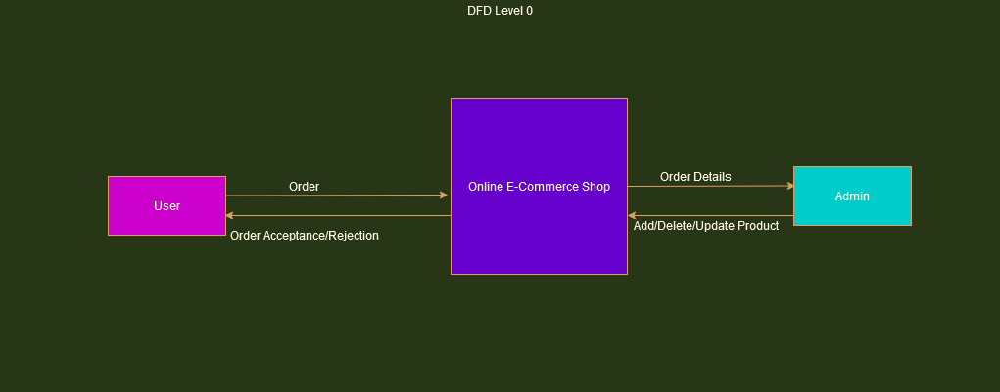
Data flow diagram Level 0

Slide 11
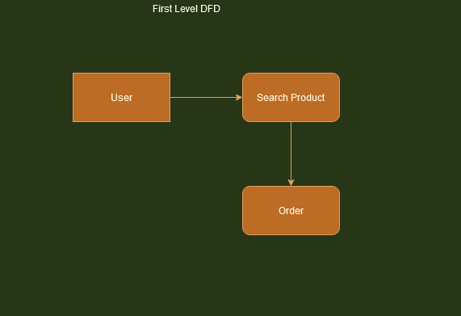
Data flow diagram Level 1

Slide 12
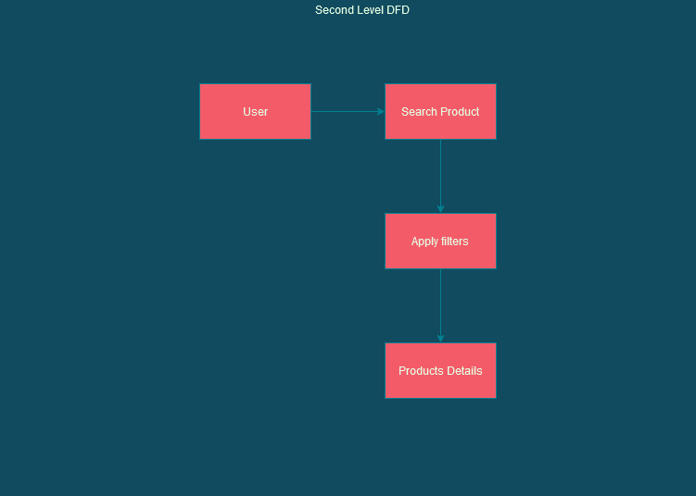
Data flow diagram Level 2

Slide 13
DESIGN APPROACH Use Case Diagram: Admin

Slide 14
DESIGN APPROACH Use Case Diagram: User

Slide 15
CONCLUSION
This project will be full development and evaluation process of the e-commerce portal. That allows products buy a single one stop marketplace or home to purchase their products. The design for the customer, administration feature and the vendor portal. All the features will be developed in PHP.

Slide 16


